Slide 1
Ounass
ETL Pipeline & Data Analysis
Case Study Submission by Sanket Raje

Slide 2

Agenda
1
5
Overview of Business Problem
Data Quality & Transformations
2
6
Solution Architecture
Data Analysis Highlights
3
7
Data Pipeline Design
Tools & Technologies
4
8
Data Models & Validations
Project Execution Overview

Slide 3
Business Problem
Objective:
Migrate production OLTP (MySQL) sales data into a PostgreSQL data warehouse for analytics.
Extract customer & order data from MySQL OLTP
Build batch ETL to PostgreSQL warehouse
Transform & validate for analytics purpose
Run pipeline daily
Avoid stressing the production system
Constraints:
OLTP is a live transactional system
Must ensure data quality & consistency
Normalize in ODS, flatten for Data Mart

Slide 4
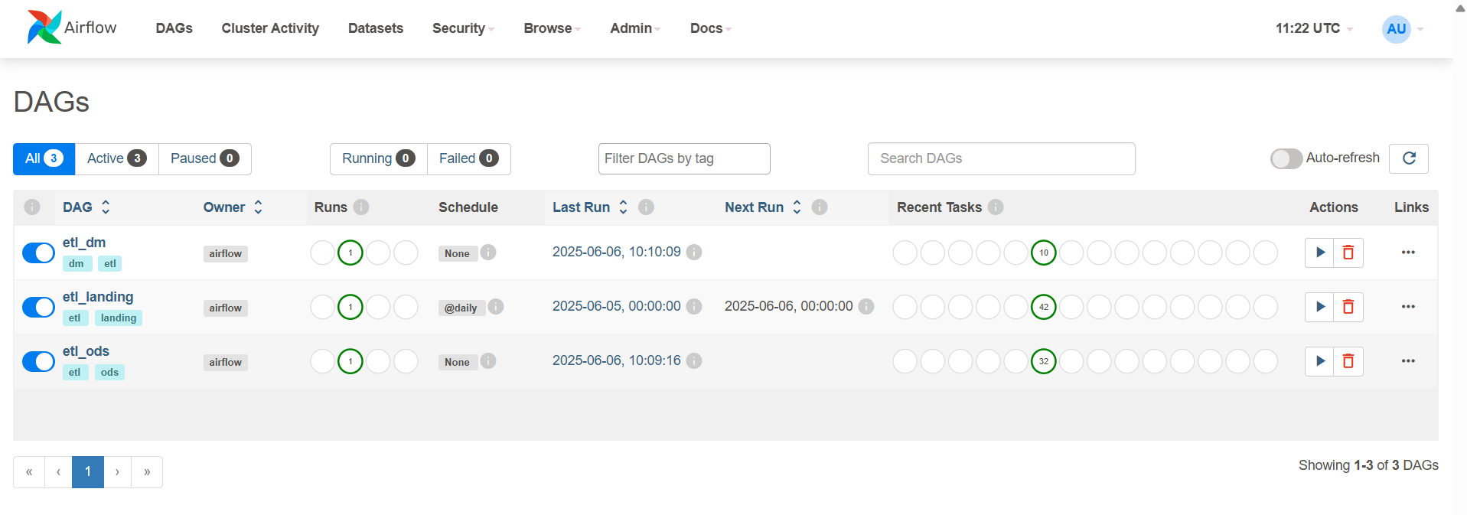
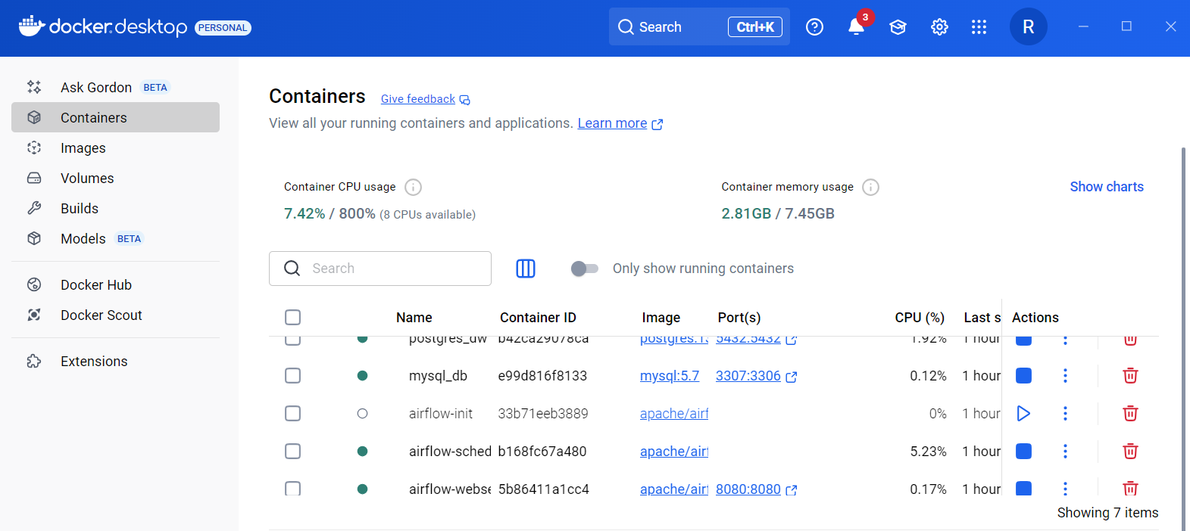
Solution Architecture
Layers:
Source DB (MySQL): Transactional System
Landing Zone: Raw load into PostgreSQL
ODS: Cleansed & normalized
Data Mart: Flattened & analytics-ready
Orchestrator: Apache Airflow, Docker containers
Processing: Python + Pandas, PostgreSQL

Slide 5
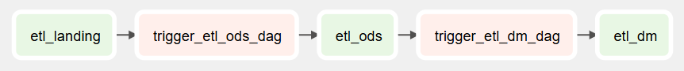
Pipeline Overview (DAGs)
DAG 1 (etl_landing): Extract from MySQL → Landing Zone
DAG 2 (etl_ods): Landing Zone → ODS
DAG 3 (etl_dm): ODS → Data Mart
Scheduled: Daily
Framework: Apache Airflow
Modular Python + Pandas code
etl_landing Source DB → Landing Zone
etl_ods Landing Zone → ODS
etl_dm ODS → Data Mart

Slide 6
Data Model – Source to Target
Normalized ODS
Flattened Data Mart
Data from MySQL is first structured into clean, relational tables in the Operational Data Store
Final table (sales_order_item_flat) combines customer, order, and item details into a single fact table
Schema Design Focus
Business Logic Embedded
Ensures referential integrity, efficient joins, and analytical readiness
Calculated fields (e.g., item_unit_total), full customer name, and cleaned email fields

Slide 7
Data Validations
Uniqueness Check
Email Format Regex Check
Null checks
Date/time formatting
Bonus: SKUs, gender values, whitespace cleanup

Slide 8
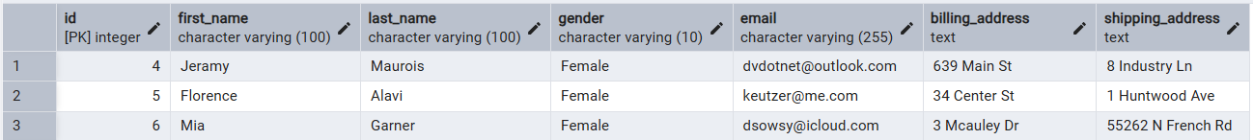
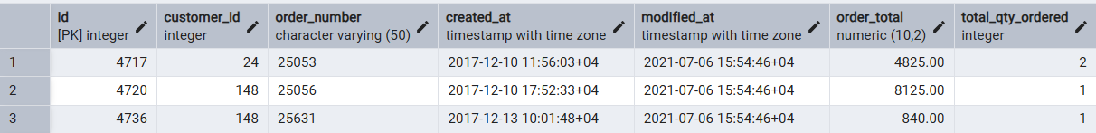
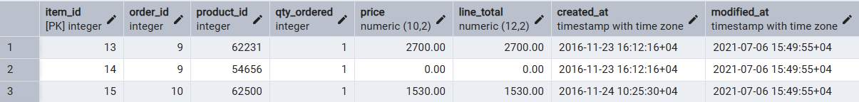
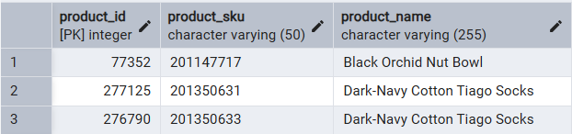
Sample Transformation Logic
Customer:
customer_name = CONCAT(first_name, ' ', last_name)
Email regex validation customer_email ~* '^[A-Za-z0-9._%+-]+ @[A-Za-z0-9.-]+ \.[A-Za-z]{2,}$’
SalesOrderItem:
item_unit_total, qty_ordered, price >= 0
modified_at >= created_at
Timestamps recorded with Time Zone

Slide 9
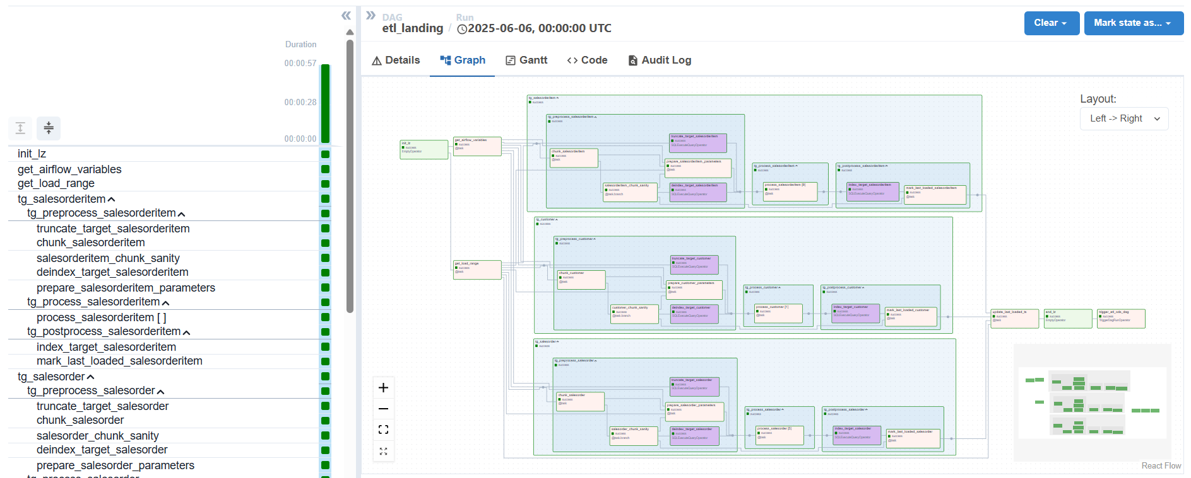
DAG: ETL Landing

Slide 10
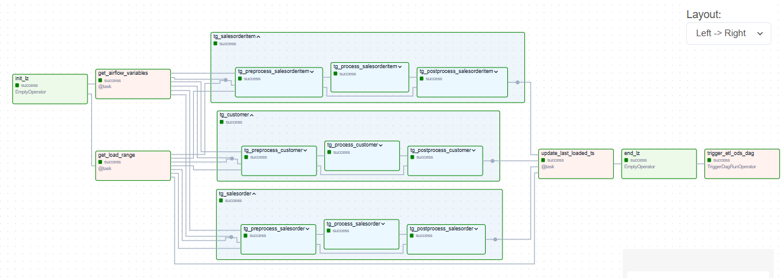
DAG: ETL Landing (high-level view)

Slide 11
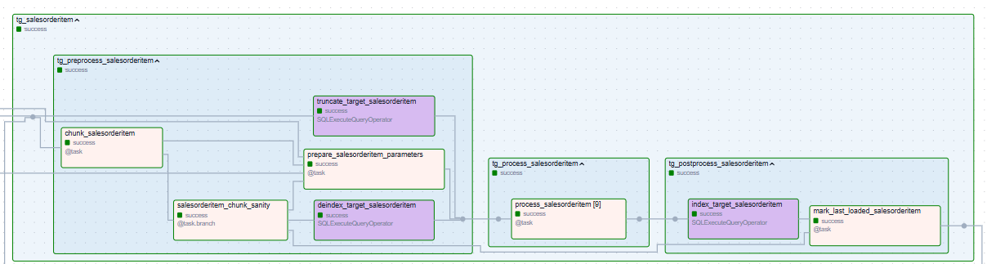
DAG: ETL Landing (low-level view)
For lz.salesorderitem Table
All landing zone tables are partitioned into 16 partitions each using:
HASH(id) for lz.customer
HASH(id) for lz.salesorder
HASH(item_id) for lz.salesorderitem
Workflow (for all target tables): Drop target indexes/constraints → Bulk inserts → Add target indexes/constraints

Slide 12
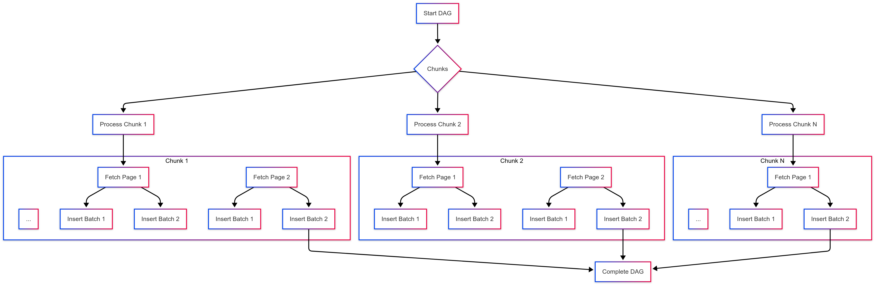
DAG: ETL Landing (Process TaskGroup)
… Parallel …
… Parallel …
… Sequential …
… Sequential …
Task-wise Chunking (chunk_size) to distribute work across parallel tasks
Chunking methods:
LIMIT/OFFSET chunks
Keyset Pagination chunks
Eg. id, modified_at
Chunk-wise Paging (page_size) to fetch data from source DB for each page in a chunk
Page-wise Batching (batch_size) to write data to target DB for each batch in a page

Slide 13
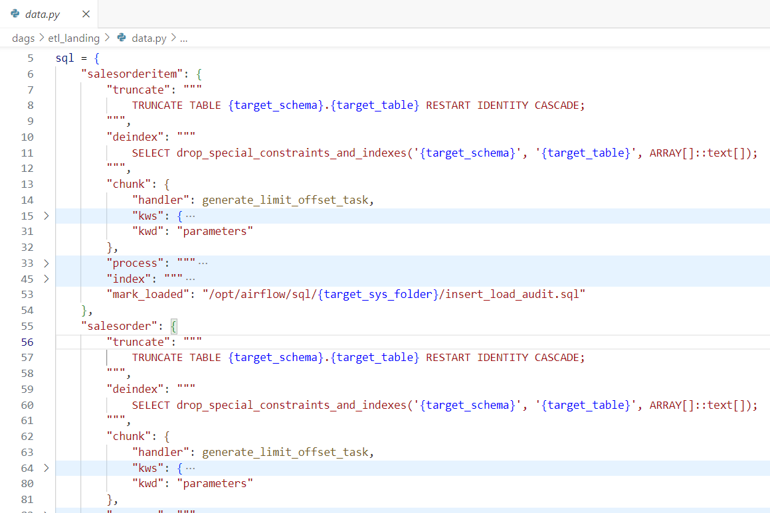
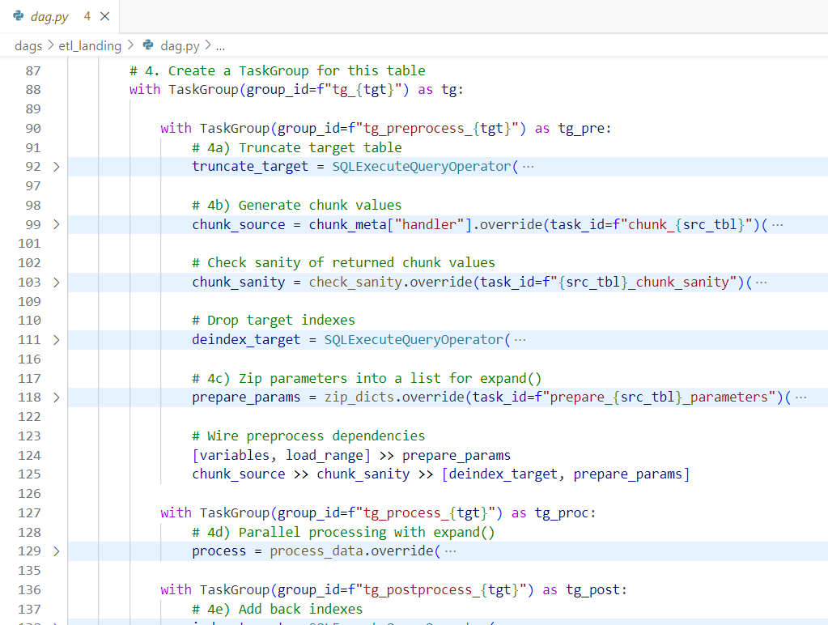
DAG: ETL Landing (Code/Data Separation)
data.py contains template sql script filepaths/queries for each table
Also contains meta-data for Task definitions and executions
dag.py contains the generic DAG structure for etl_landing
Loops through all target tables and generates TaskGroups & Tasks dynamically using data in data.py

Slide 14
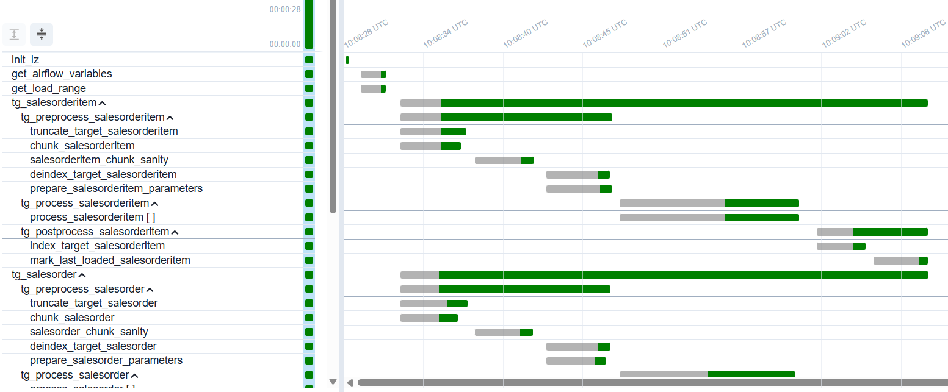
DAG: ETL Landing (Gantt Chart)
Note: There is a delay between scheduled time and execution time of tasks because of airflow scheduler & executor polling intervals

Slide 15
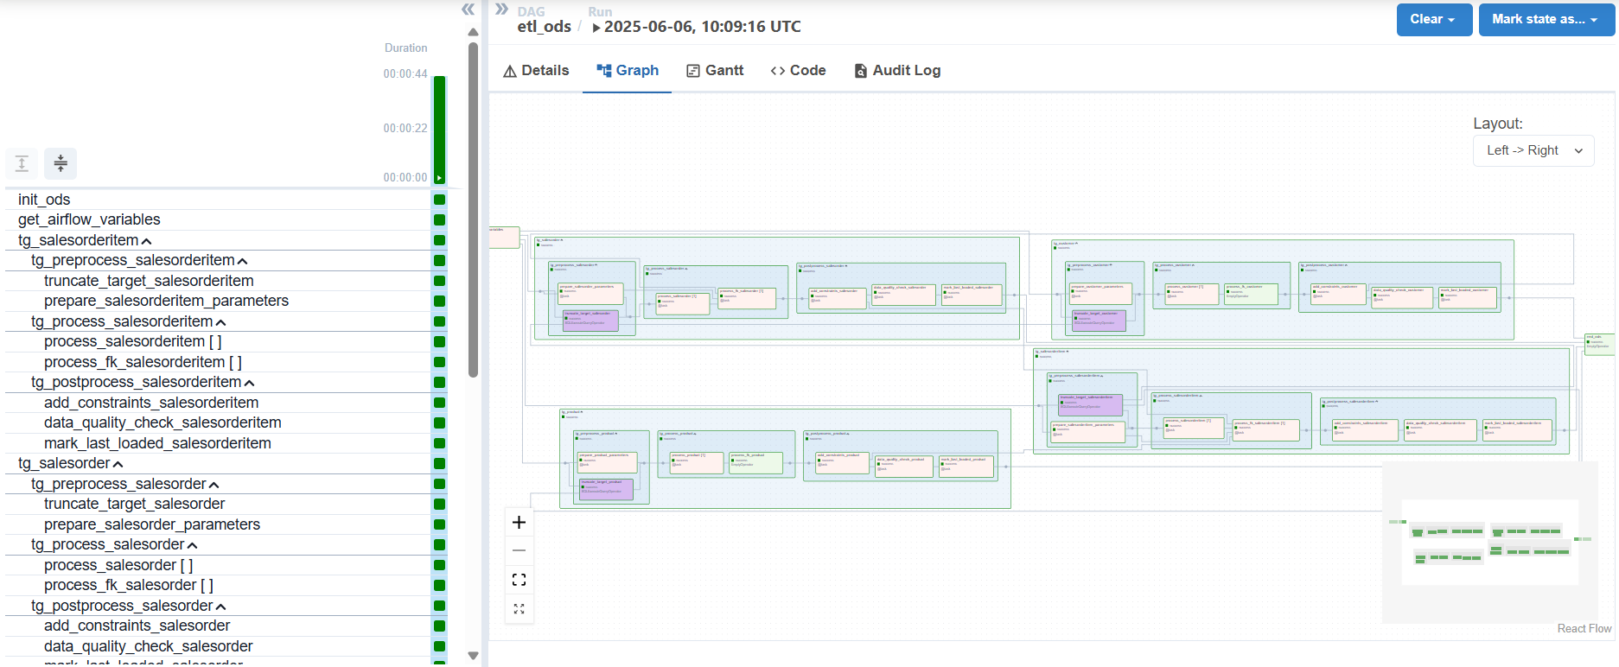
DAG: ETL ODS

Slide 16
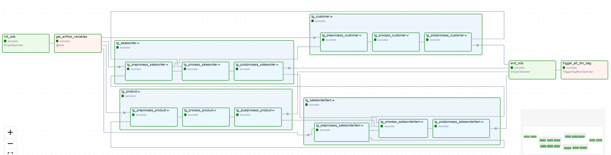
DAG: ETL ODS (high-level view)

Slide 17
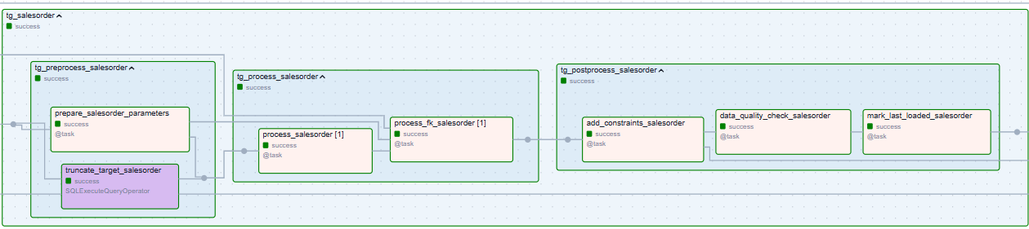
DAG: ETL ODS (low-level view)
For ods.salesorder Table
Workflow (for all target tables): Drop target indexes/constraints → Bulk inserts → Add target indexes/constraints

Slide 18
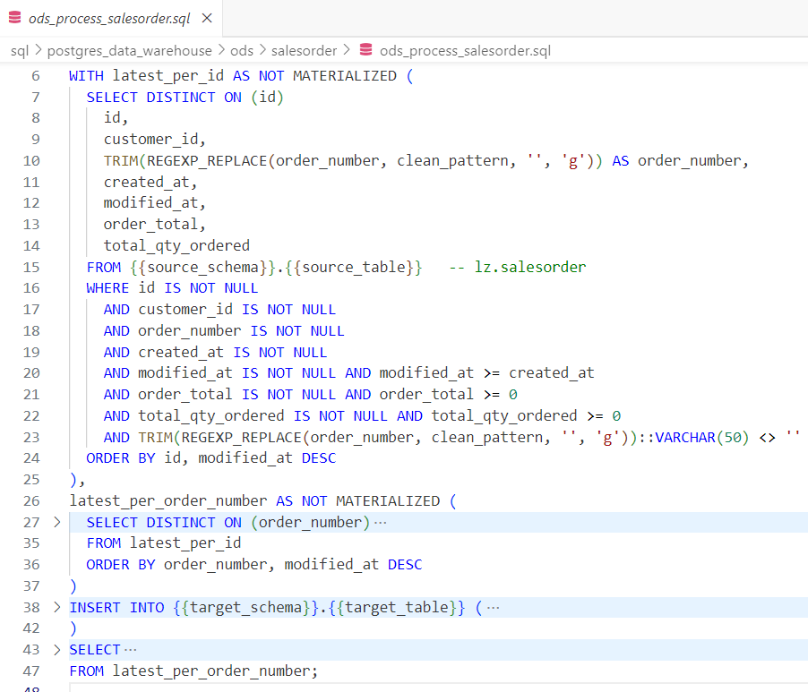
DAG: ETL ODS (Process TaskGroup)
Maximize processing inside PostgreSQL
PostgreSQL is optimized for compute, memory, and parallelization
Both target tables (ods) and source tables (lz) reside inside PostgreSQL database
Avoids overhead of transfer to and from pandas dataframes.
Keep best practices for SQL queries like
using non-materialized CTE’s
SELECTing only the required columns
doing proper filtering and cleaning of each column
Deduplication of records
proper Indexing of source table to speed up queries

Slide 19
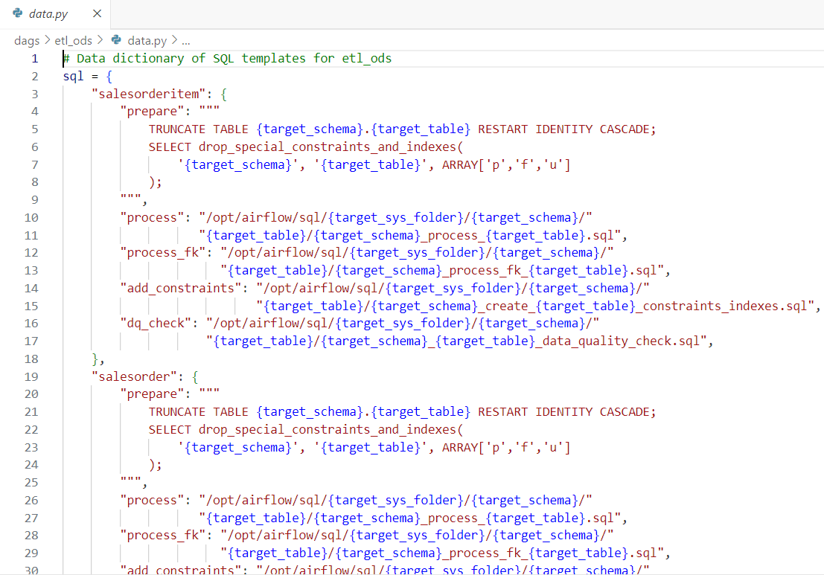
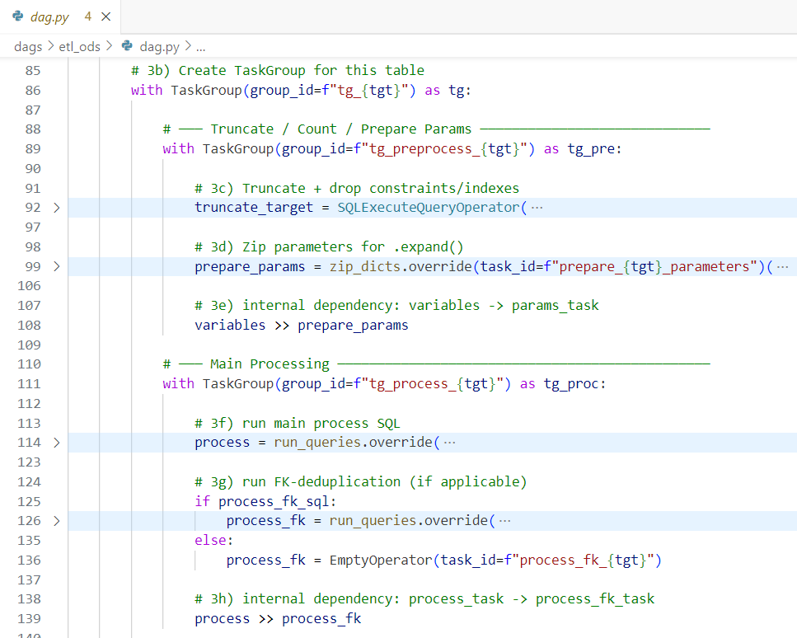
DAG: ETL ODS (Code/Data Separation)
data.py contains template sql script filepaths/queries for each table
Also contains meta-data for Task definitions and executions
dag.py contains the generic DAG structure for etl_landing
Loops through all target tables and generates TaskGroups & Tasks dynamically using data in data.py

Slide 20
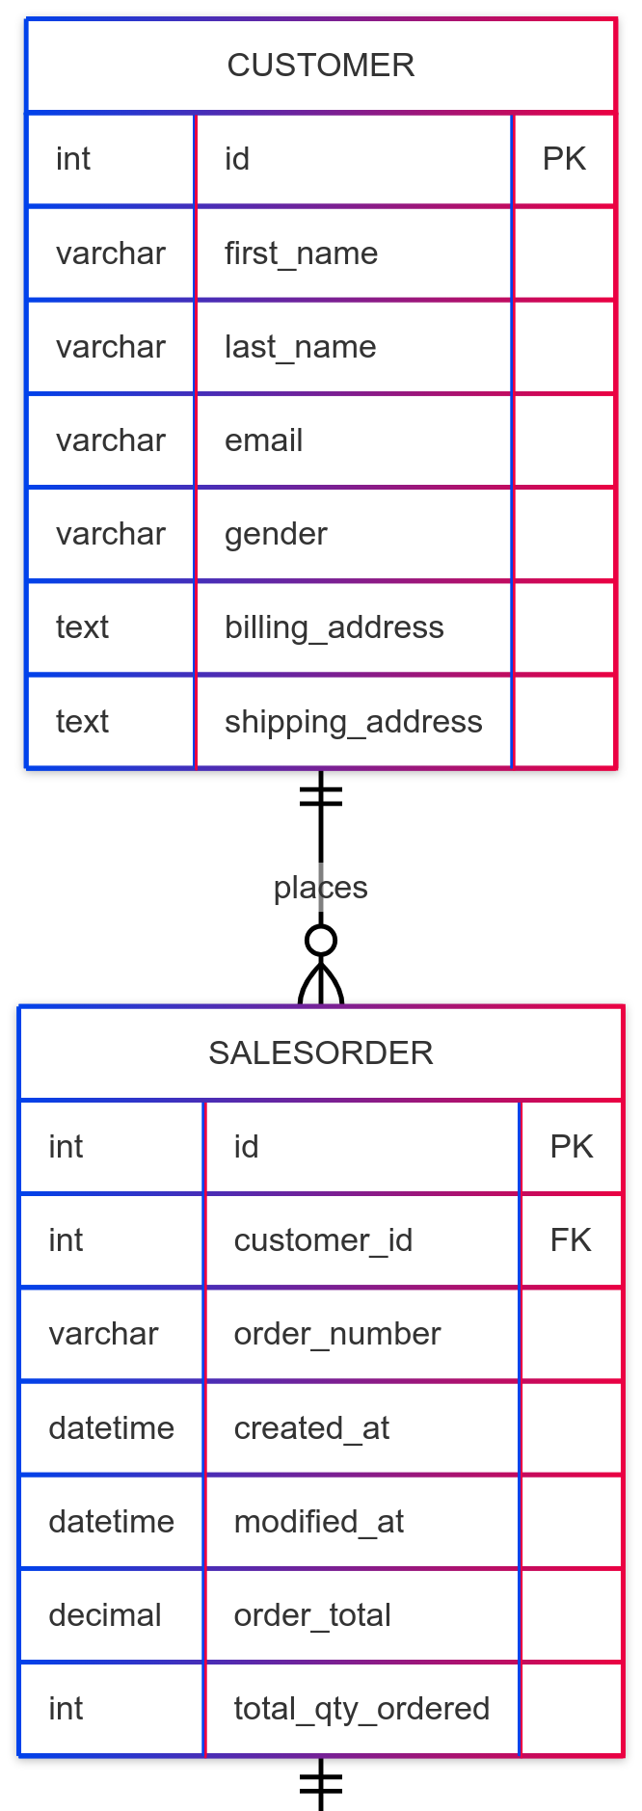
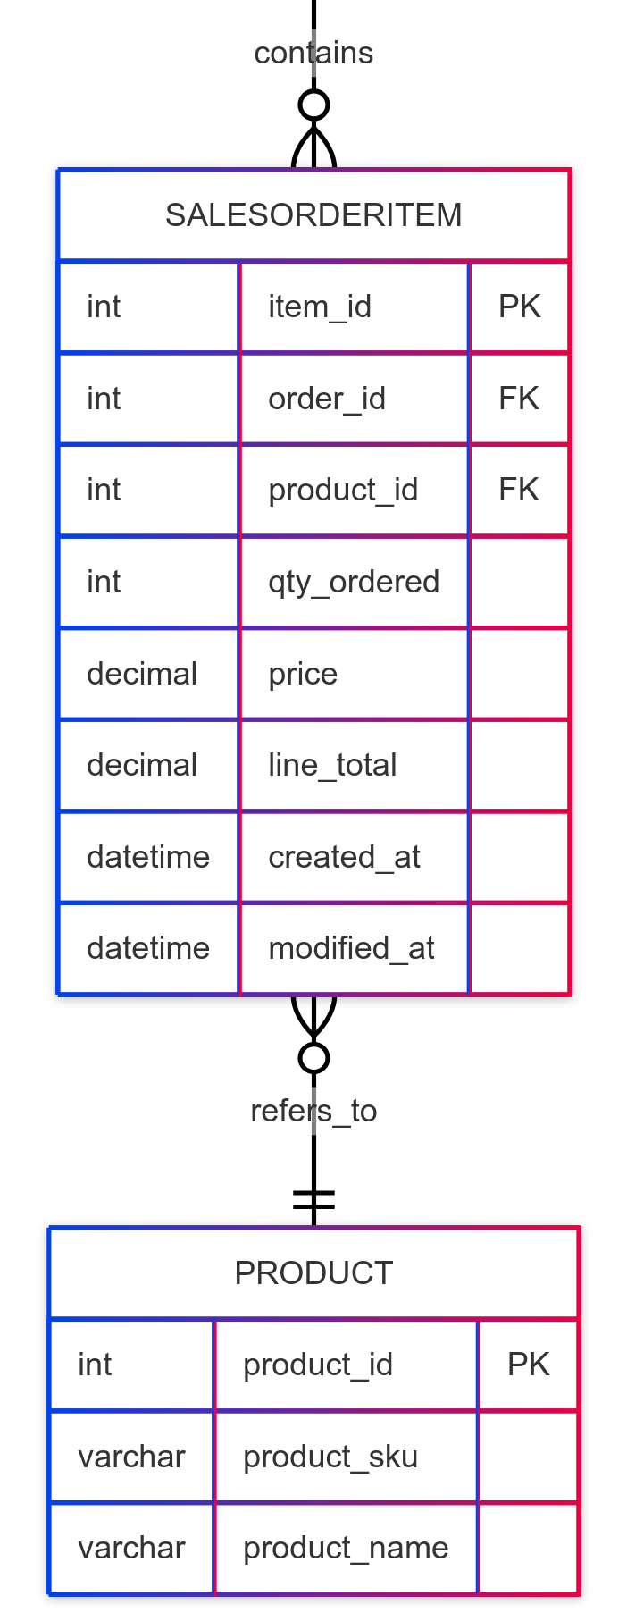
DAG: ETL ODS (ER Diagrams)
Normalization of ods tables in ods schema: ods.customer, ods.salesorder, ods.salesorderitem
ods.customer, ods.salesorder are already normalized from their source lz. counterparts
ods.salesorderitem was normalized by creating a ods.product table and storing product details liks product_sku, product_name in it
ods.salesorderitem has a foreign key product_id which refers to the product_id in ods.product table

Slide 21
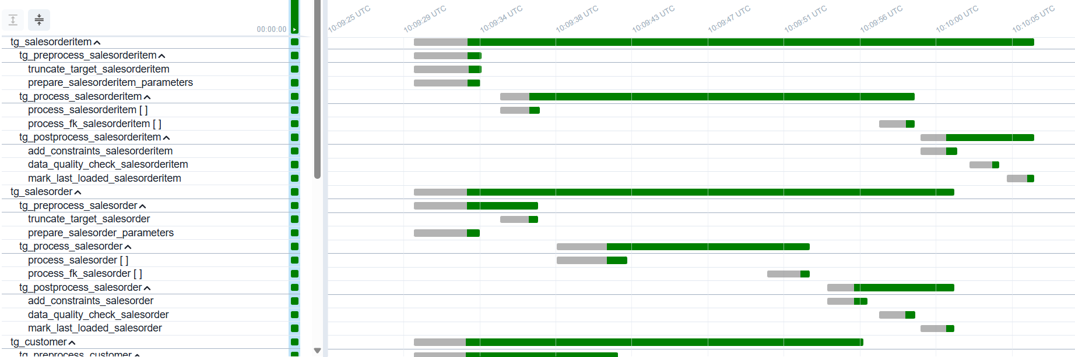
DAG: ETL ODS (Gantt Chart)
Note: There is a delay between scheduled time and execution time of tasks because of airflow scheduler & executor polling intervals

Slide 22
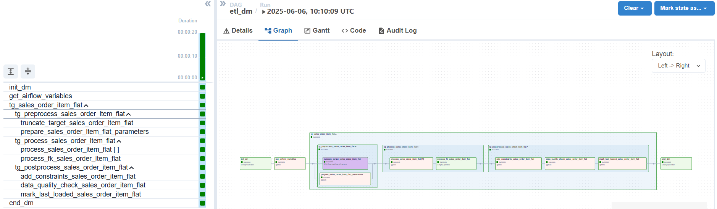
DAG: ETL Data Mart

Slide 23
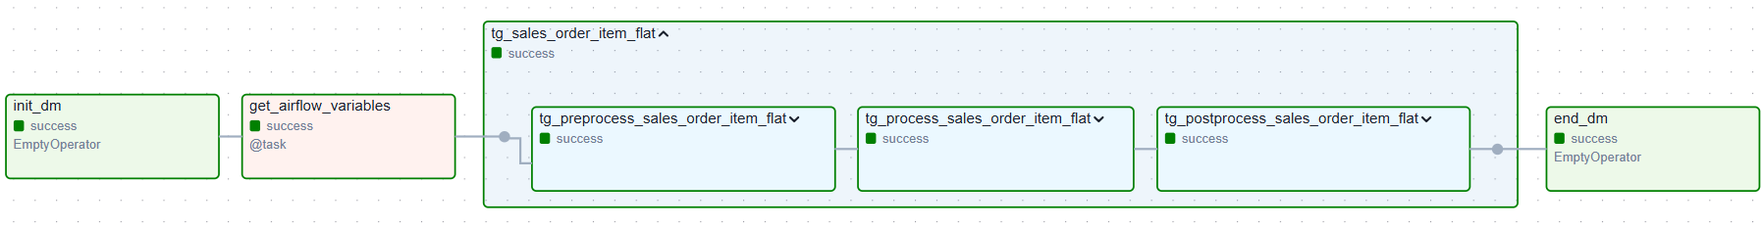
DAG: ETL Data Mart (high-level view)
High-level Workflow:
Get required airflow variables for this DAG’s configuration
Preprocess: check source sanity, prepare process parameters, prepare target table (drop indexes/constraints)
Process: load, process, insert into target table
Postprocess: add target table indexes/constraints
Modular
Easily extendible to multiple target tables chains
Configure Task parallelization parameters like max_tis_per_dag, pool

Slide 24
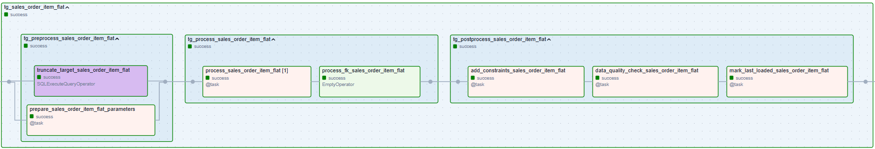
DAG: ETL Data Mart (low-level view)
For dm.sales_order_item_flat Table
All Data Mart tables are partitioned into 16 partitions each using:
HASH(item_id, order_id) for dm.sales_order_item_flat
Workflow (for all target tables): Drop target indexes/constraints → Bulk inserts → Add target indexes/constraints

Slide 25
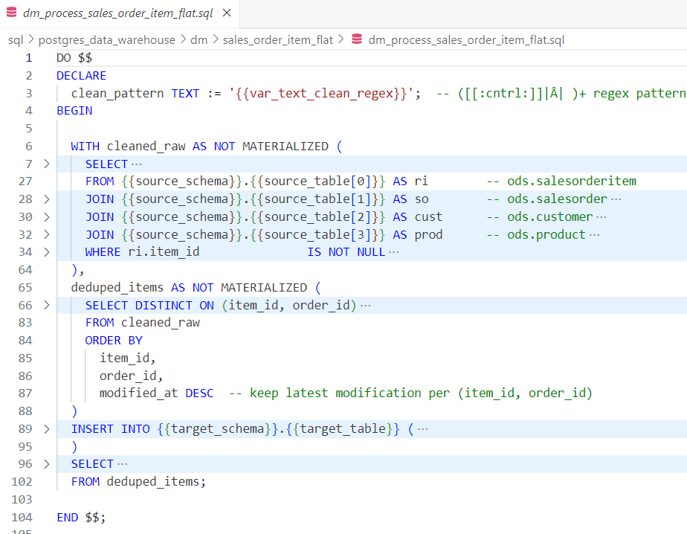
DAG: ETL Data Mart (Process TaskGroup)
Maximize processing inside PostgreSQL
PostgreSQL is optimized for compute, memory, and parallelization
Both target tables (dm) and source tables (ods) reside inside PostgreSQL database
Avoids overhead of transfer to and from pandas dataframes.
Keep best practices for SQL queries like
using non-materialized CTE’s
SELECTing only the required columns
doing proper filtering and cleaning of each column
Deduplication of records
proper Indexing of source table to speed up queries

Slide 26
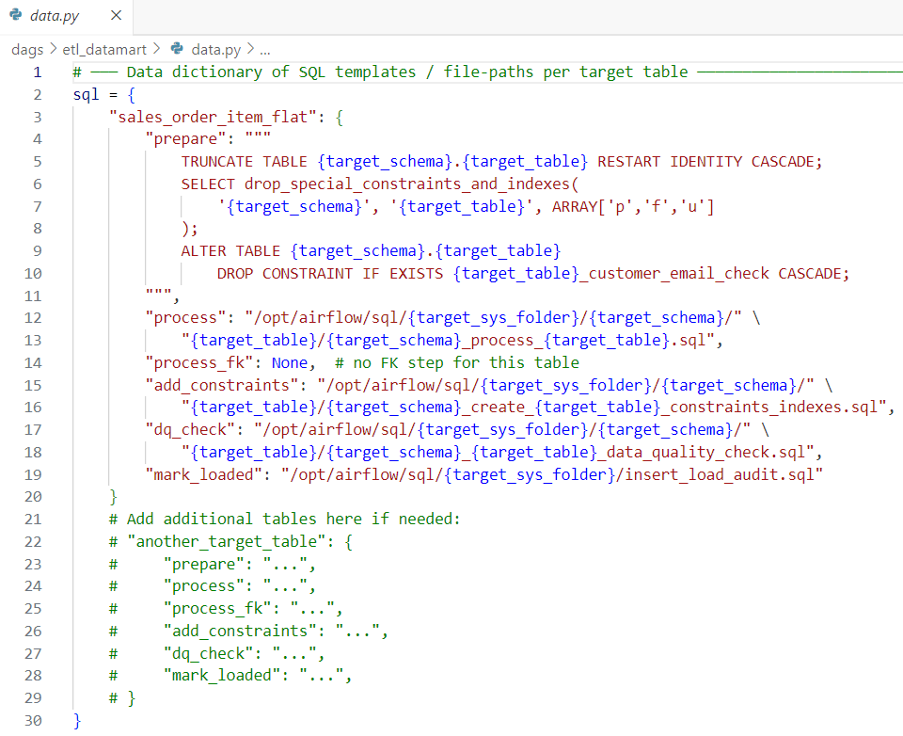
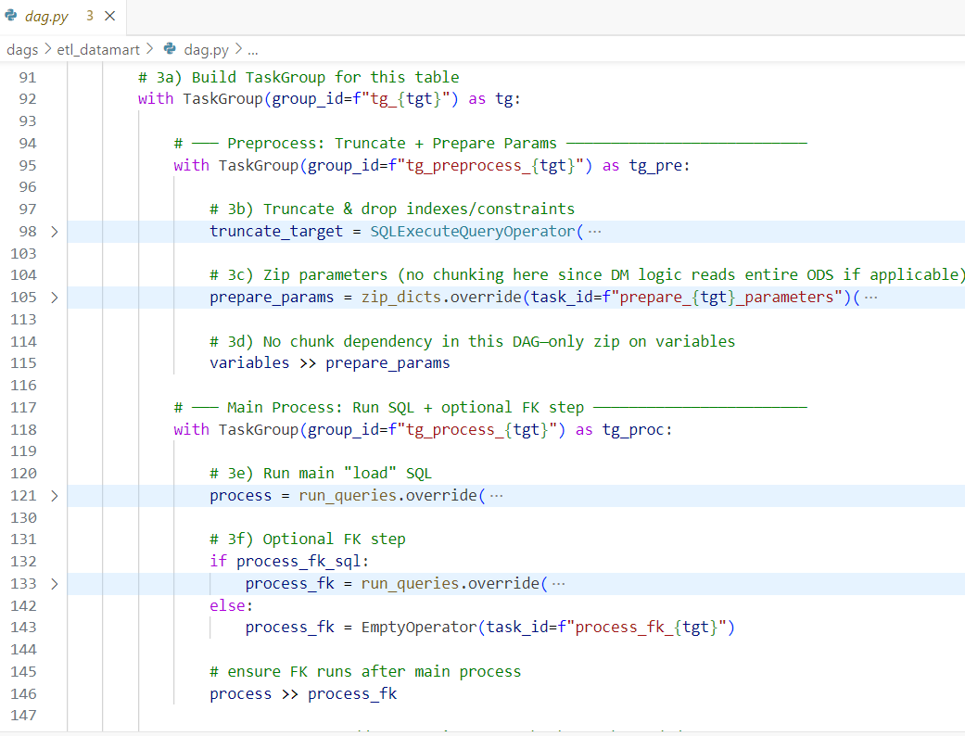
DAG: ETL Data Mart (Code/Data Separation)
data.py contains template sql script filepaths/queries for each table
Also contains meta-data for Task definitions and executions
dag.py contains the generic DAG structure for etl_landing
Loops through all target tables and generates TaskGroups & Tasks dynamically using data in data.py

Slide 27
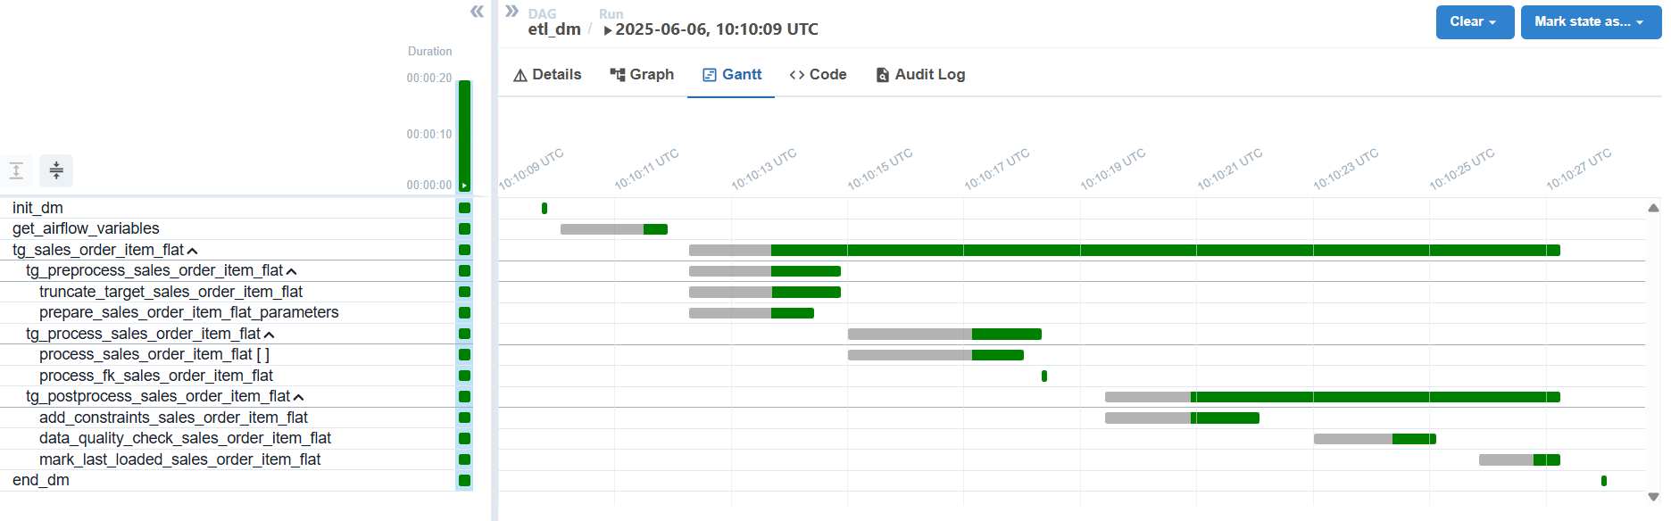
DAG: ETL Data Mart (Gantt Chart)
Note: There is a delay between scheduled time and execution time of tasks because of airflow scheduler & executor polling intervals

Slide 28
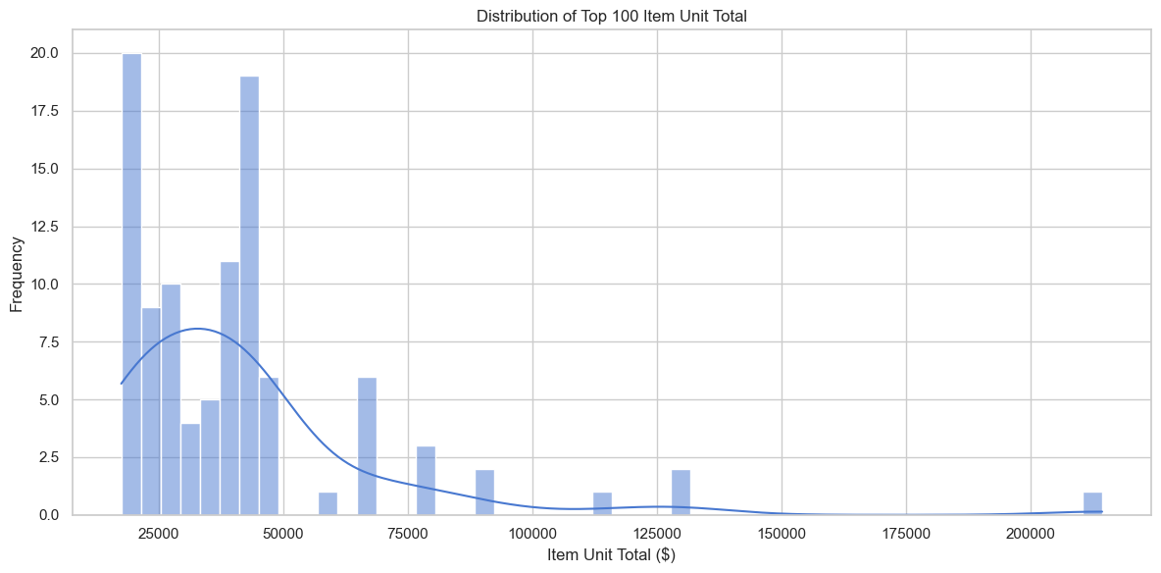
Data Analysis Insights
📈 Sales Trends
🛍️ Top 10 Products
👤 Customer Segmentation
📦 Average Order Size
Rolling Averages on total sales
Pairplot and Correlation
Statistical Analysis using Pearson Coefficient
Linear Regression fit on Item-Price vs. Item Unit Total
Time Series Forecast using ARIMA on weekly sales

Slide 29
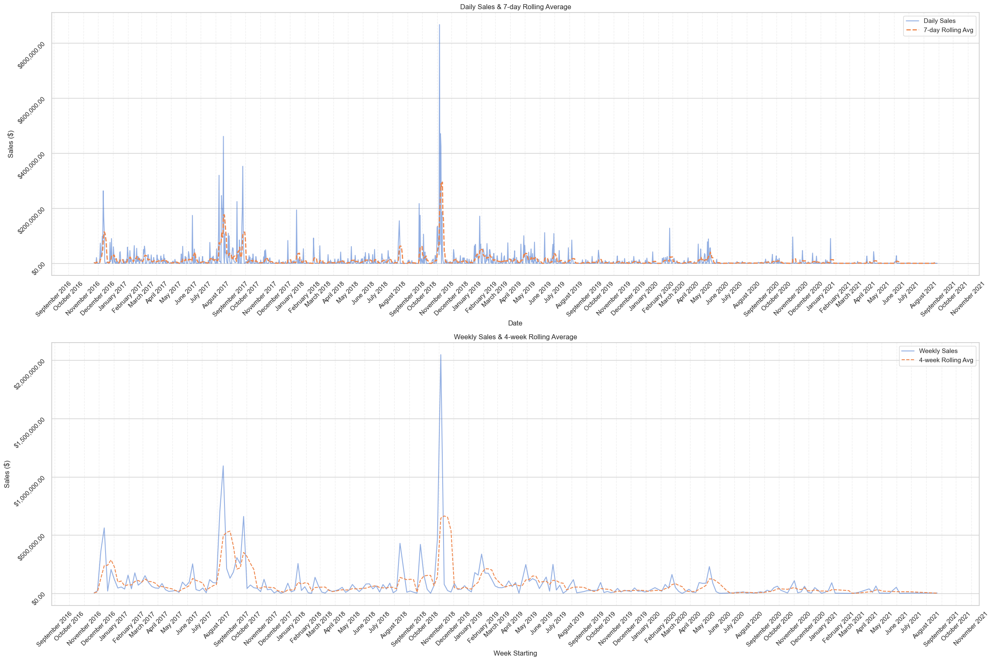
Data Analysis Insights

Slide 30
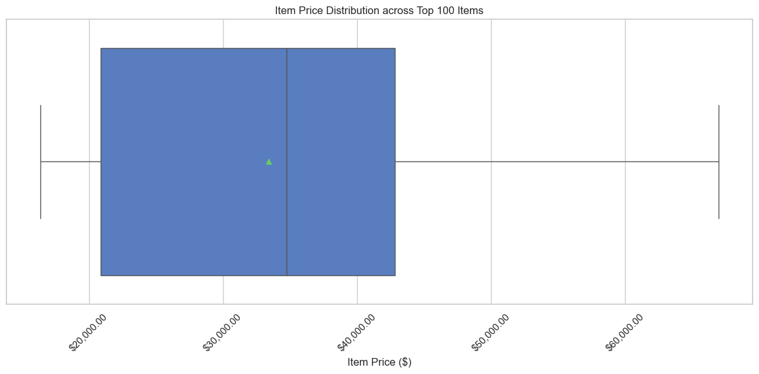
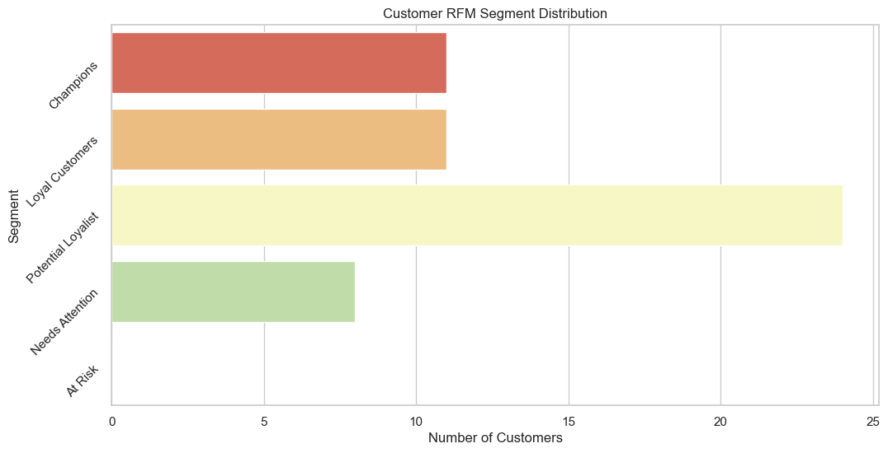
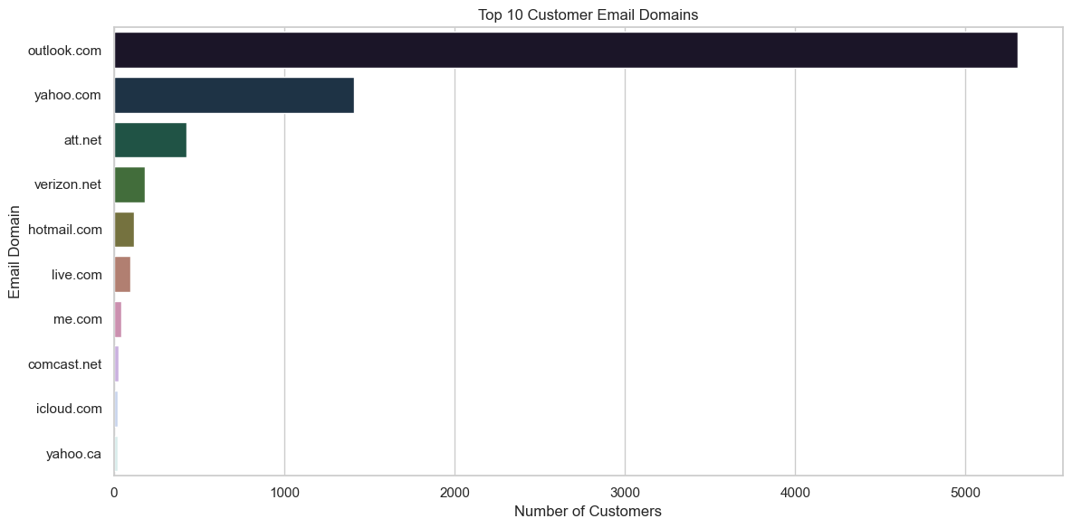
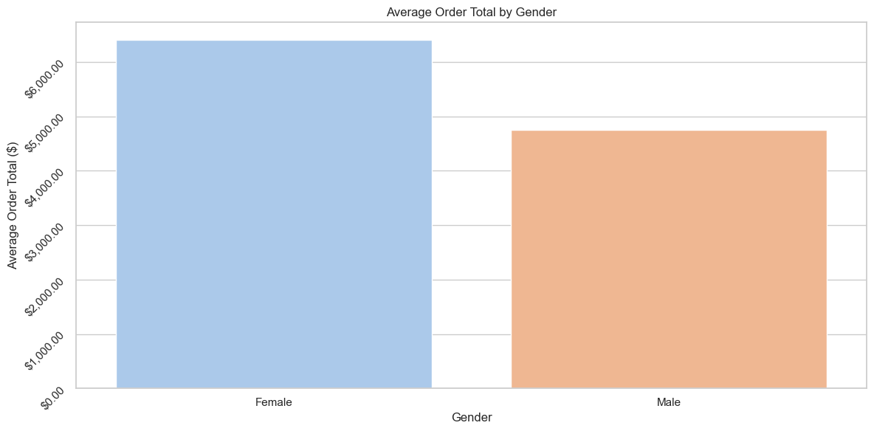
Data Analysis Insights

Slide 31
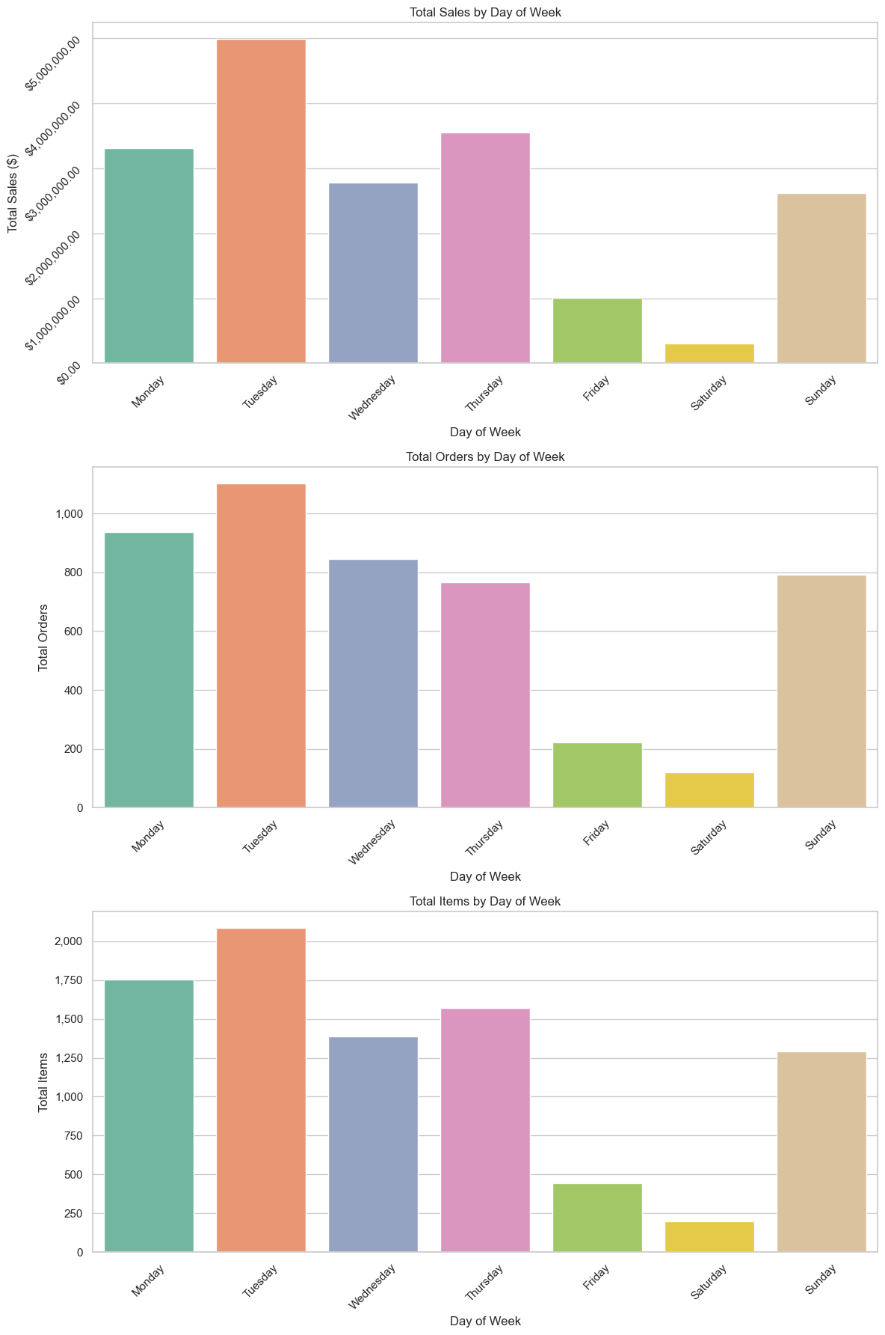
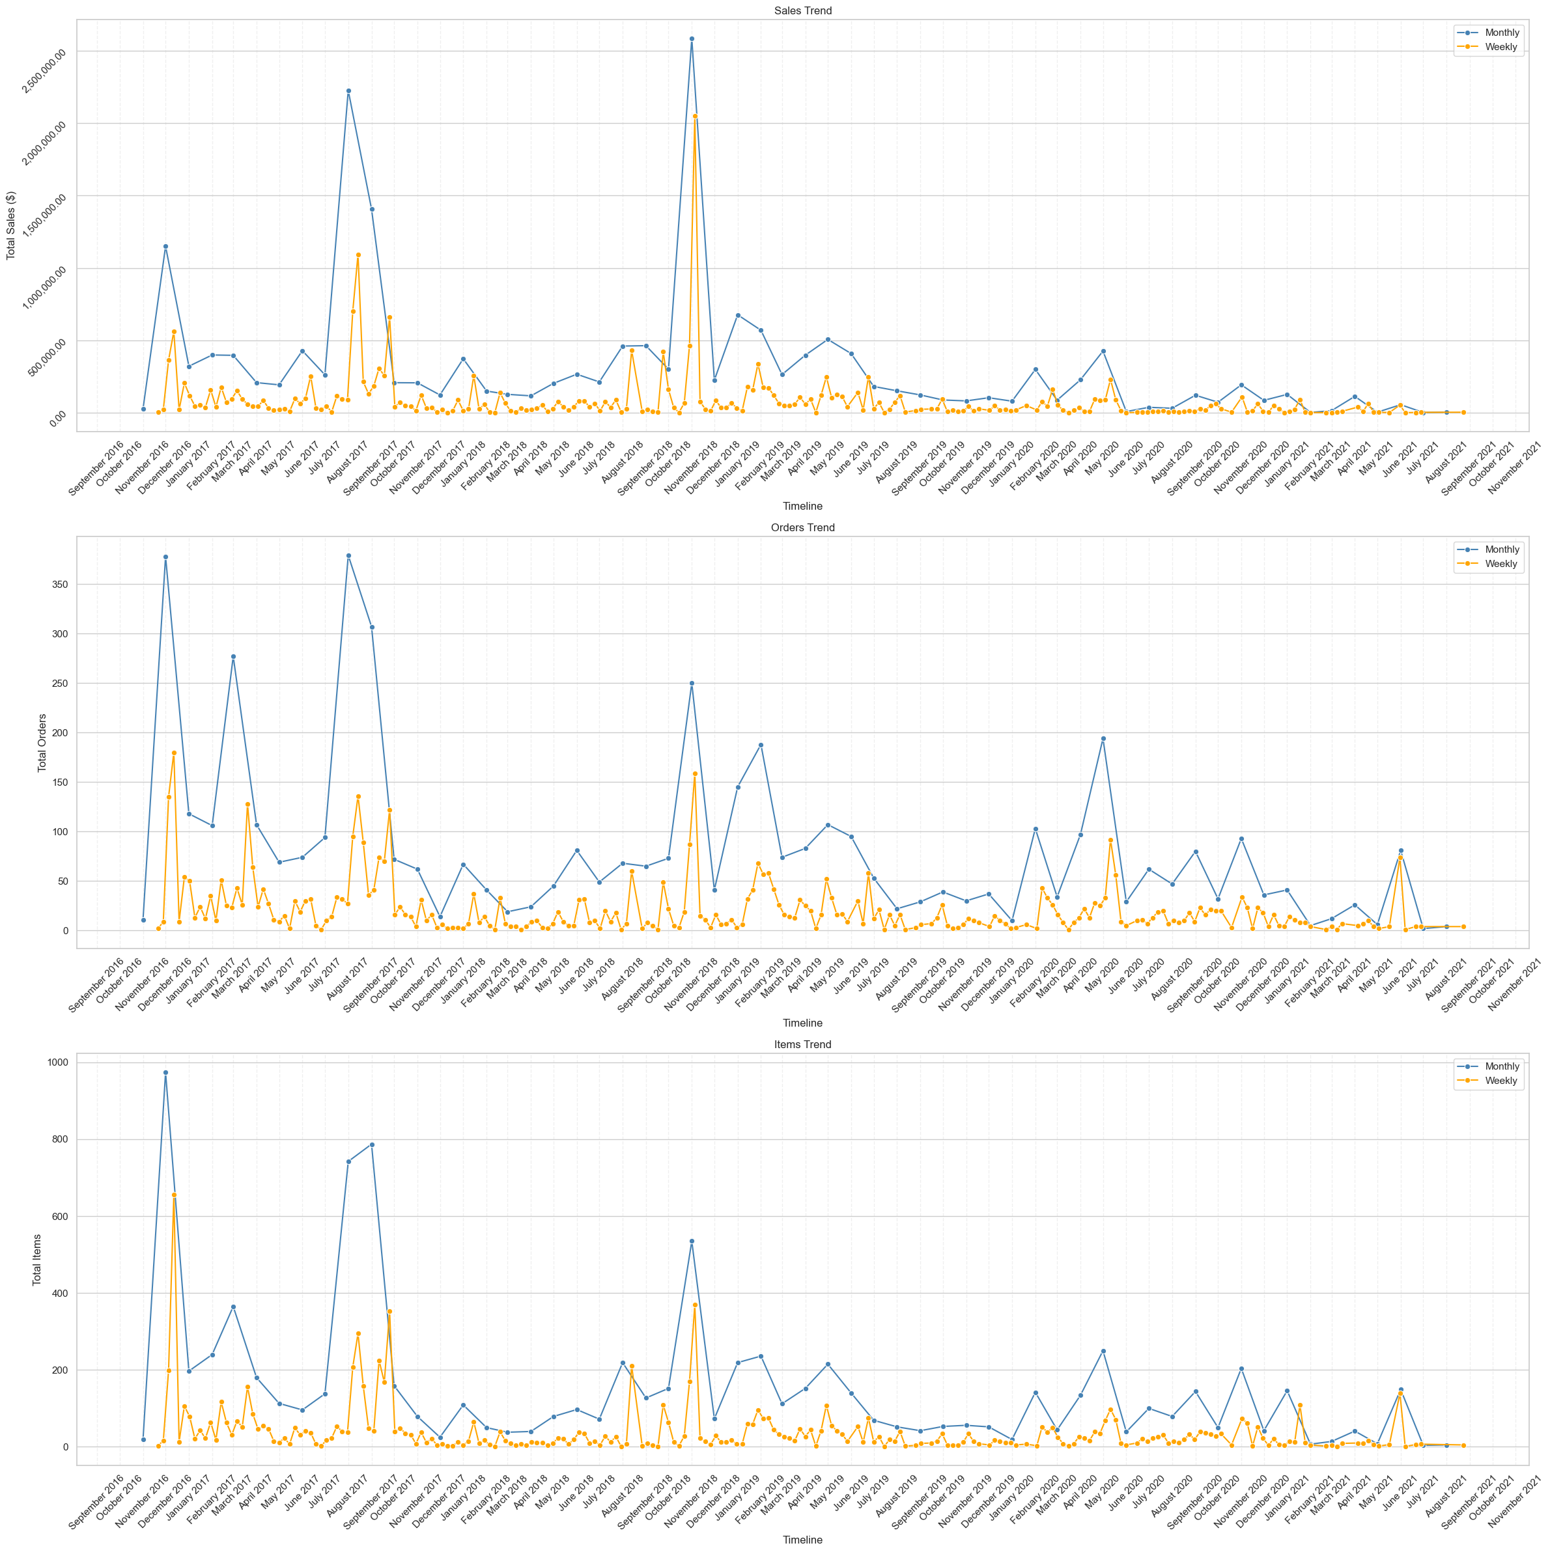
Data Analysis Insights

Slide 32
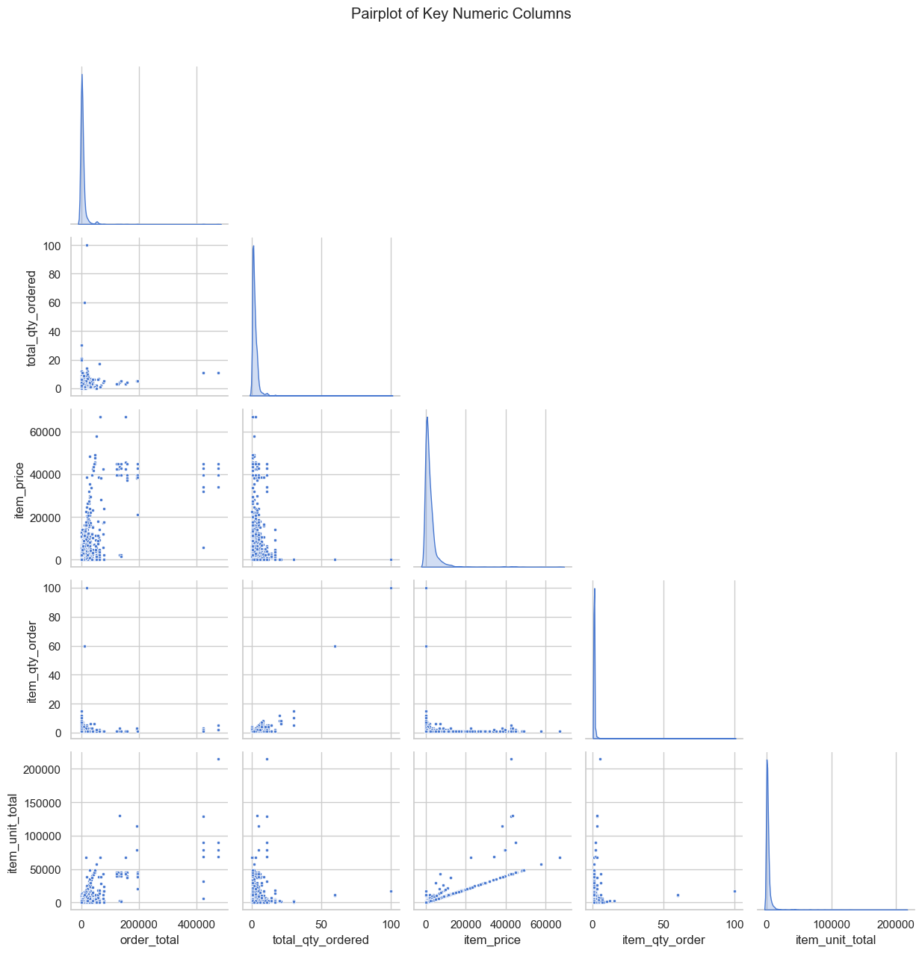
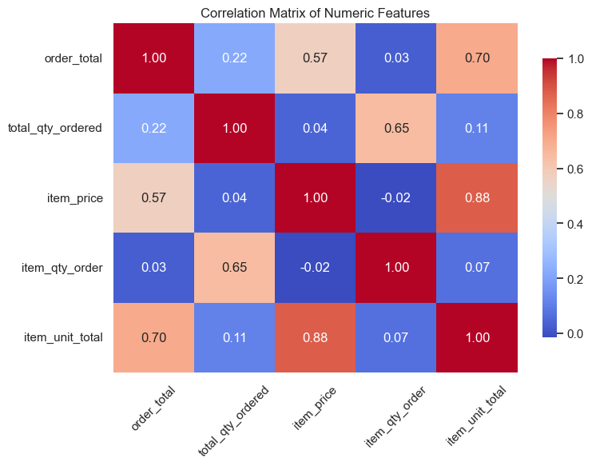
Data Analysis Insights

Slide 33
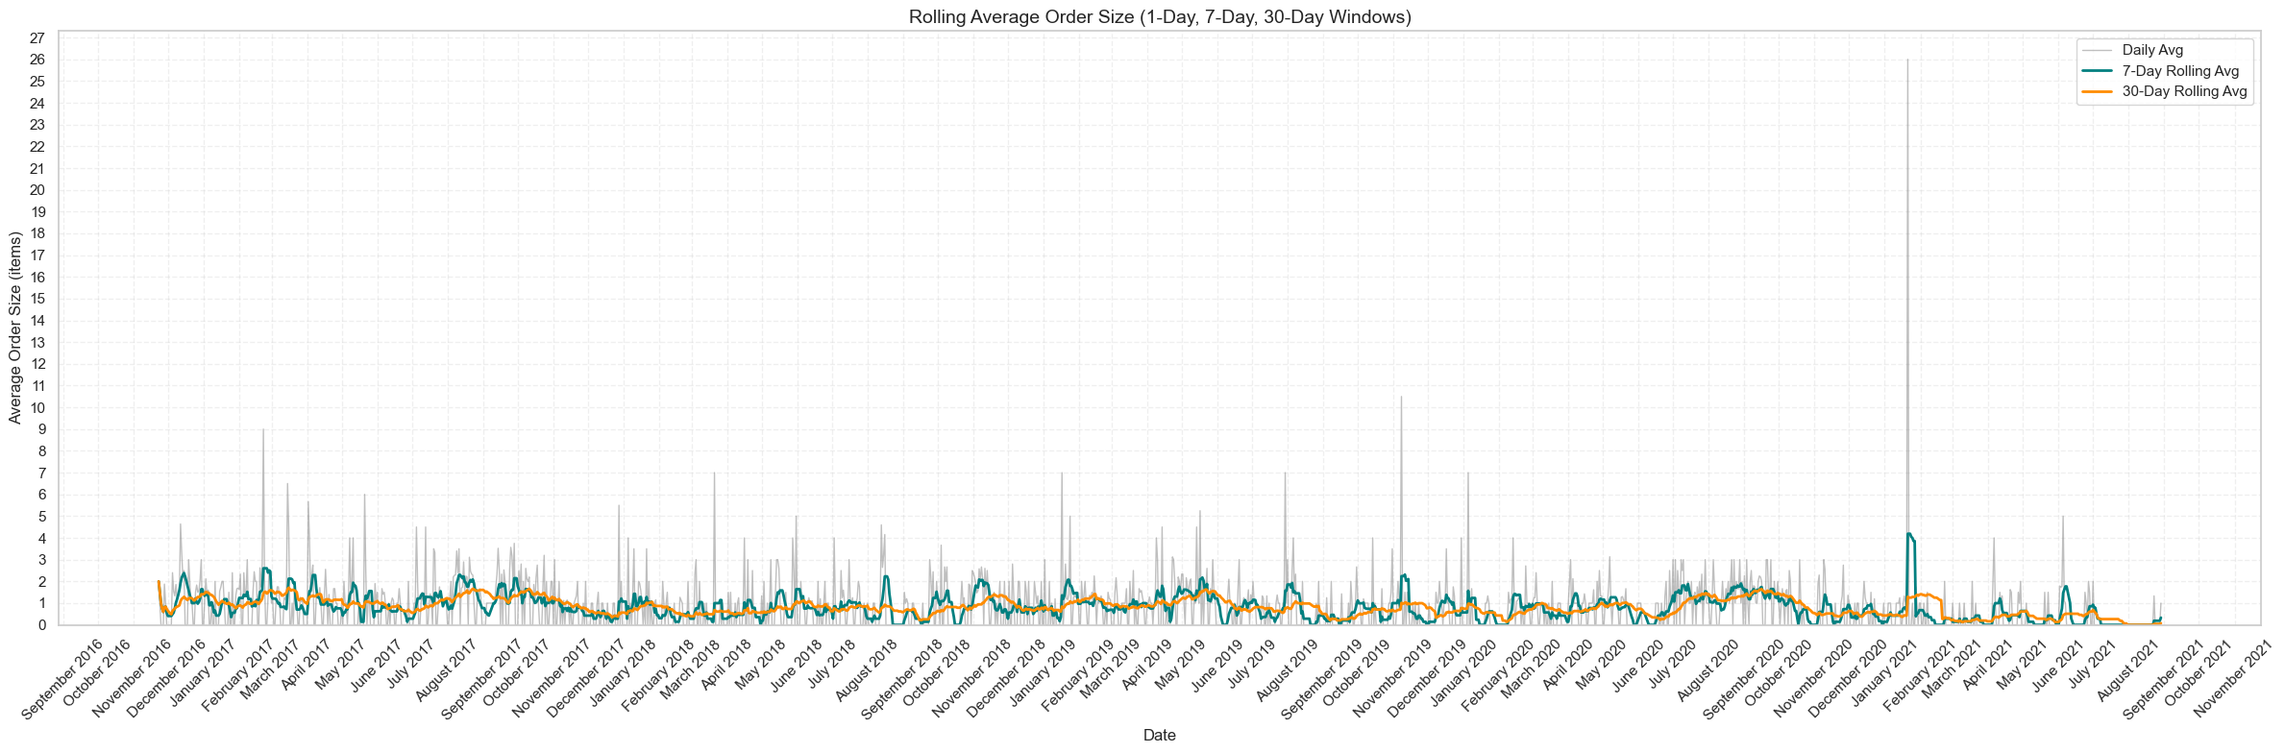
Data Analysis Insights

Slide 34
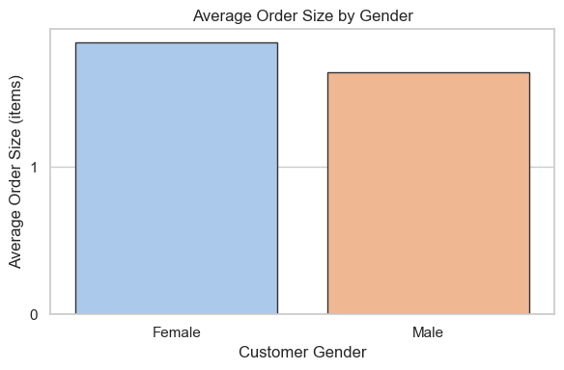
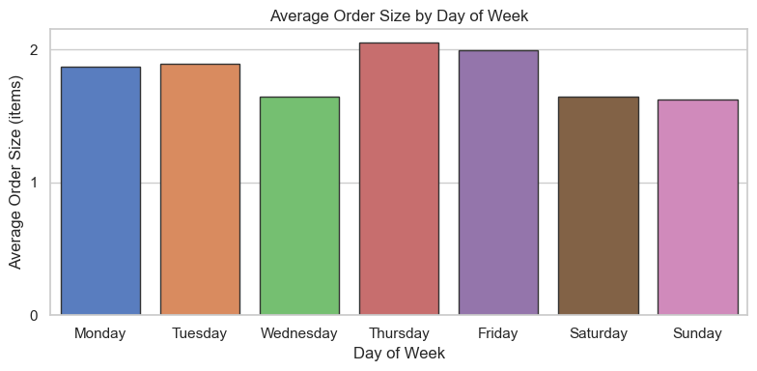
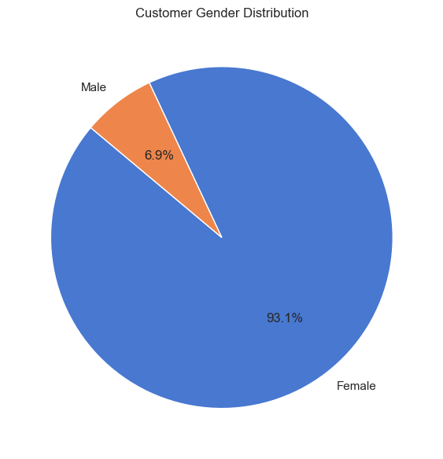
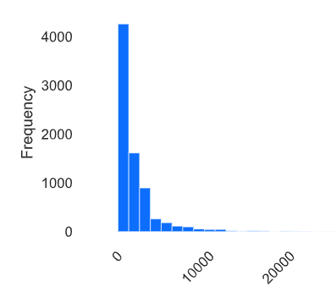
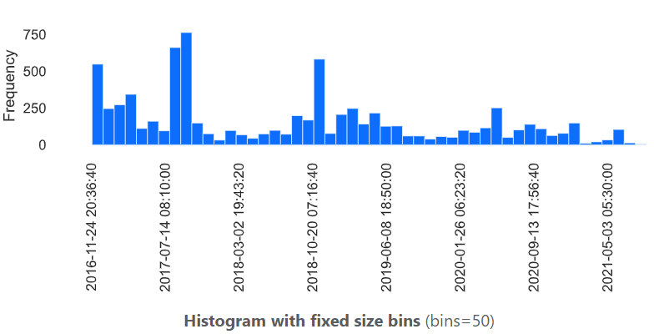
Data Analysis Insights
Item Price (Histogram - Cropped)
Order Created At (Histogram)

Slide 35
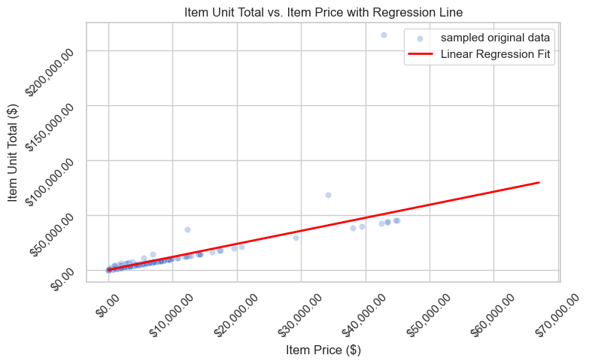
Data Analysis Insights

Slide 36
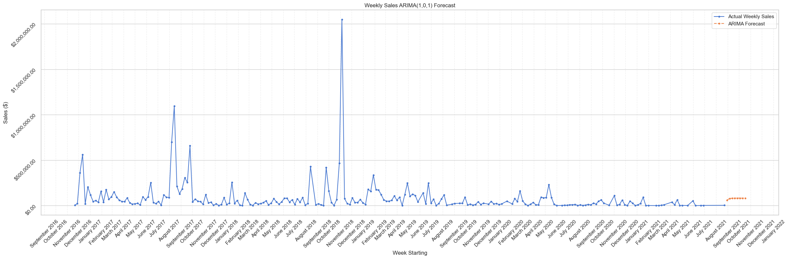
Data Analysis Insights

Slide 37
Tools & Technologies
Orchestration: Apache Airflow
Source DB: MySQL
Data Warehouse: PostgreSQL
ETL: Python, Pandas
Validation: Regex
Deployment: Docker
Visualization: Jupyter Notebook/Power BI
Analysis: Pandas, Scipy, Scikit-learn, Statsmodels, Ydata-profiling
Plotting: Matplotlib, Seaborn

Slide 38
Project Execution Overview
Docker Compose
Airflow DAGs
Modular Scripts
Notebook Analysis
GitHub Repository

Slide 39
Challenges & Learnings
Challenges
First time using Apache Airflow (DAGs, scheduling, task failures)
Adjusting Docker setup for Airflow on local system
Managing a 3-stage ETL (Landing → ODS → Data Mart)
Ensuring robust data validation & schema checks
Learnings
Quickly picked up Airflow orchestration & modular DAGs
Improved skills in data cleaning with Pandas
Hands-on with PostgreSQL & data warehousing
Applied existing cloud & DevOps knowledge to optimize workflows
Proved strong learning agility under real-case pressure

Slide 40

Thank You!
Q&A
Please feel free to reach out to me:
sanketraje777@gmail.com
+91 7709436925
linkedin.com/in/sanketraje

